Slide 1
Joint Working Group Meeting Thursday April 13th, 2017
Introductions
Goal of the meeting
Nitrogen Loading Assessment
Presentation
Questions
Clarification
Background Information

Slide 2
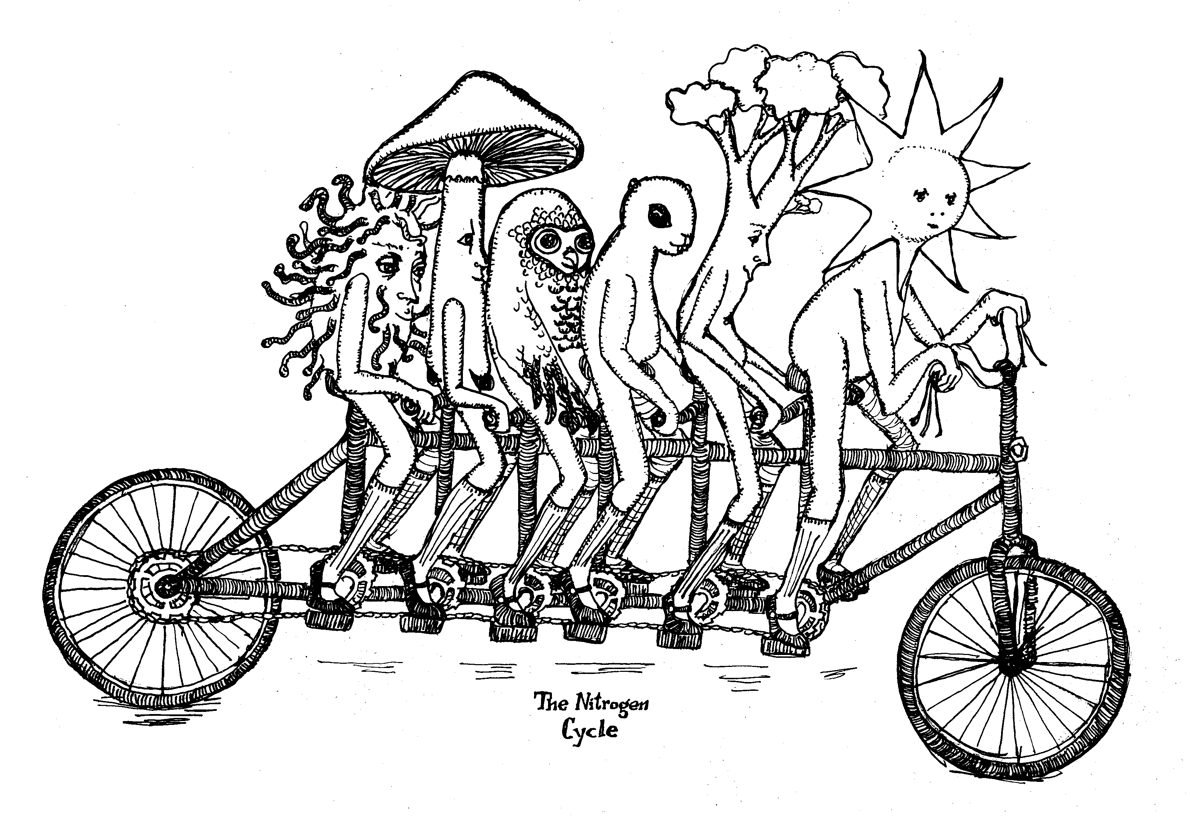
Andrew Bary
Nitrogen Cycle
Nitrogen Fate and Transport
Composting

Slide 4
Nitrogen Loading Assessment
Goals:
Develop a better understanding of the relative nitrogen sources in the Lower Valley.
Support the GWMA’s goal of reducing nitrate concentrations in groundwater.
Meet the GWAC’s needs
Assist with directing future limited resources.
Assist with developing strategies that will reduce nitrogen loading and improve nitrogen use efficiencies.

Slide 5
Process:
Draft authored by WSDA and Yakima County
Peer review
Working group review
GWAC review

Slide 6
Nitrogen Loading Assessment
Defensible
Transparent
Understand how decisions were made
Assumptions used
References
Methodology
When best professional judgement was used along with rationale
Limitations
Sensitivity Analysis
Reproducible
Standard consistent format, easy to read and understand.

Slide 7
This document is:
Designed to be:
Not Designed to be:
An educated estimate of the relative major nitrogen sources in the Lower Yakima Valley.
Qualitative rather than quantitative
A living document that can be refined as better data is generated.
Loading to the land surface (not groundwater)
Best bang for our buck.
Precise
A vehicle for pinpointing specific sources.

Slide 8
Agenda:
Ground Rules:
Be respectful
Be productive
Be open-minded
Offer solutions
Livestock
Irrigated Agriculture
RCIM (residential, commercial, and Industrial)
Atmospheric Deposition

Slide 9
Thank You to everyone who has been involved, and for your patience.

Slide 11
Questions/ Issues / Next Steps

