Slide 1
Estimated Nitrogen Available for Transport in the Lower Yakima Valley Groundwater Management Area
Natural Resources Assessment Section
Washington State Department of Agriculture
http://www.agr.wa.gov/PestFert/NatResources/
April 13, 2017

Slide 2
Topics
CAFO
Irrigated Ag
Residential Commercial Industrial and Municipal (RCIM)
Atmospheric Deposition
Conclusions
Next Steps

Slide 3
CONCENTRATED ANIMAL FEEDING OPERATIONS

Slide 4
CAFO Background
Harter 2002, van der Schans 2009
California, monitoring wells
Attempted to measure N loading from each management unit
Hard to isolate management units, largest total contributor on dairies was cropland due to large acreage

Slide 5
CAFO Management Units
Irrigated cropland
Animal housing (pens, barns, pastures)
Compost areas
Impoundments (lagoons, ponds, settling basins)

Slide 6
Pens and Compost: Identification
Initial identification: Google Earth, 2013 USDA NAIP
Dairy CAFO, Nondairy CAFO, or Compost
QA (10%)
GIS, file geodatabase
  Location, classification, outline, area, calculation results

Slide 7
Pens and Compost: Dairy CAFO
Close to registered dairy
Stocking rate based on DNMP registration, acreage
No unique loading rate
Excludes pastured animals
Excludes buildings (barns, freestalls, milking parlors)
No calculation of storage

Slide 8
Pens and Compost: Nondairy CAFO
Known feedlot
Far from known dairy, not convenient to milking parlor
Stocking rate unknown
Does not include animals on range or pasture
No unique loading rate
No calculation of storage

Slide 9
Pens and Compost: Compost
Compost windrows, location
Acreage calculated
No calculation
  Little available information

Slide 10
Pens: Results and Discussion
 | Acres | %
Dairy CAFO pens | 1,597 | 60.7
Nondairy CAFO pens | 499 | 18.9
Compost | 536 | 20.4
Total (pens and compost) | 2,632 | 100

Slide 11
Pens and Compost: Literature
Mielke et al. 1974, Miller et al. 2008,
Vaillant et al. 2009
Manure-soil interface layer forms through microbial action and compaction
Inhibits infiltration
Contaminant concentrations elevated in soil beneath feedlots
Maintenance and surface conditions important

Slide 12
Pens and Compost: Calculations
Literature information: rate of N loss through pen surface
Local information: pen locations, outlines, acreage, and categorization
These rates account for atmospheric deposition
No calculation: N storage, N emission

Slide 13
Pens and Compost: Calculations
Low: 75 kg N/ha-yr (67 lb N/ac-yr)
Tulare Lake Basin (similar meteorological conditions to Yakima GWMA)
High: 1,000 kg N/ha-yr (892 lb N/ac-yr)
Tulare Lake Basin, Salinas Valley, San Joaquin Valley, Kansas (variety of meteorological conditions)
“For the TLB…the upper bound is likely a conservatively high value and likely to significantly exceed actual loading rates, perhaps by as much as one order of magnitude.”
Viers et al., p 142

Slide 14

Pens: Results and Discussion
$$N loss rate \left(\frac{lb N}{acre∙year}\right) ×Pen acreage \left(acre\right)=$$
$$Total Estimated N Loss\left(\frac{lb N}{year}\right)$$
 | lb N/ac-yr | Ton N/yr
Low rate (Viers et al. 2012) | 67 | 70
Medium rate (average) | 480 | 502
High rate (Viers et al. 2012) | 892 | 935

Slide 15
Lagoons: Identification
Initial identification: Google Earth, 2013 USDA NAIP
Categorized by use (lagoon vs pond) (NRAS and DNMP)
QA (10%) and comparison with DNMP lagoon assessment data
GIS, file geodatabase
  Location, classification, outline, area, dimensions, calculation result

Slide 16
Lagoons: Limitations
Lagoon: Impoundment primarily used for storing manure
No further categorization (lagoon, settling basin, settling pond, irrigation pond)
No calculation of storage, no condition assessment

Slide 17
Lagoons: Methodology
Darcy’s Law: describes fluid flow through porous media
Literature information (liner permeability and thickness)
Local information (dimensions, nitrogen concentration)
Amount of nitrogen expected to pass through liner
Transport and fate of nitrogen through soil profile not evaluated

Slide 18
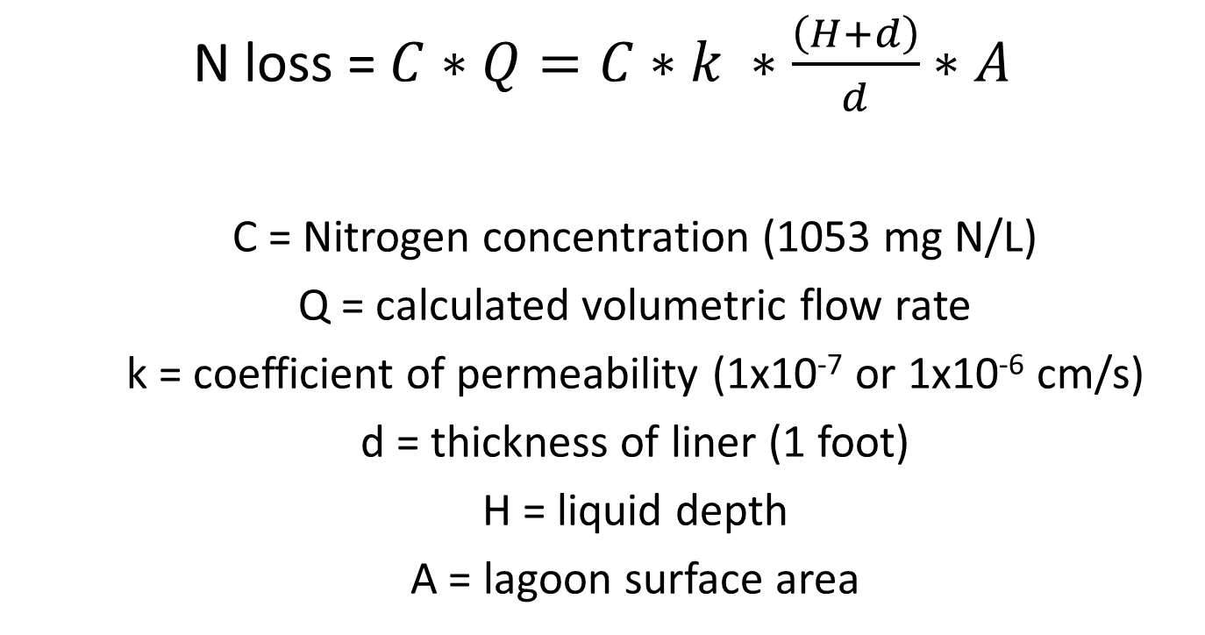
Lagoons: Methodology
N loss = $C∗Q=C∗k ∗\frac{\left(H+d\right)}{d}∗A$
  C = Nitrogen concentration (1053 mg N/L)
  Q = calculated volumetric flow rate
  k = coefficient of permeability (1x10⁻⁷ or 1x10⁻⁶ cm/s)
  d = thickness of liner (1 foot)
  H = liquid depth
  A = lagoon surface area

Slide 19
Lagoons: Nitrogen Concentration
EPA sampling in 2010
  15 samples from 5 dairies
  1 inflow and 2 outflow at each dairy
  290-1,800 mg N/L, mean 1,212 mg N/L
South Yakima Conservation District
  Data voluntarily provided by producers
  23 test results provided, estimated 15-20 dairies
  180-3,624 mg N/L, mean 949 mg N/L

Slide 20
Lagoons: Nitrogen Concentration
Combined set: 38 results with mean of 1,053 mg N/L
Higher than literature values
These testing results would account for atmospheric nitrogen deposition
No adjustment for N loss to atmosphere

Slide 21
Lagoons: Nitrogen Concentration
Campbell Mathews et al. 2011, Pettygrove et al. 2010
47-2,420 mg TKN/L, mean 570 mg TKN/L
165-465 mg N/L
670 mg TKN/L

Slide 22
Lagoons: Liner Permeability
NRCS requirements are based on specific discharge rates
Historically used permeability: 1 x 10⁻⁶ cm/s
Additional reduction from manure sealing assumed: 1 x 10⁻⁷ cm/s
Discussed with GWMA workgroups in 2015
Rates similar to experimental values (Ham 2002 permeability of 1.8 x 10⁻⁷ cm/s)

Slide 23
Lagoons: Liner Permeability
Ham 2002
Seepage from 20 lagoons
  14 swine, 5 feedlot, 1 dairy
Range 0.2-2.4 mm/day
Mean 1.1 mm/day
Permeability: 1.8x10⁻⁷ cm/s

Slide 24
Lagoons: Liner Thickness
NRCS standards based on depth
16 feet or less = 1 foot liner thickness
Average depth in GWMA 11.3 feet
Standard of 1 foot used
Consistent with literature

Slide 25
Lagoons: Depth
Depth
  individual design depth if known
  average design depth (11.3 ft)
Percent capacity: 43%
  Based on DNMP lagoon assessment data
Depth adjusted to 43% of design depth or average

Slide 26
Lagoons: Surface Area
Design dimensions if known
Aerial imagery (length x width)
Polygon area (DNMP assessment)
Surface area adjusted to 73% of design surface area

Slide 27
Lagoons: Results
 | N Loss (lb N/ac-year) | N loss (ton N/year)
Low | 1,354 | 142
Medium | 7,448 | 781
High | 13,542 | 1,421

Slide 28
Lagoons: Discussion
Viers et al, 2012
141-1,407 lb N/ac-yr (UC Davis)
vs
1,354-13,542 lb N/ac-yr (WSDA)
Lagoon nitrogen concentration (500 mg N/L)
Loading vs N available
Experimentally determined rates (UC Davis)
Theoretical model (WSDA)

Slide 29
CAFO Conclusions and Recommendations
Improvements to estimate
  Measured lagoon seepage rates in GWMA
  Statistical sampling of total nitrogen concentrations in lagoons and soil nitrogen concentrations below pens
Maintenance and inspection of facilities

Slide 30
IRRIGATED AGRICULTURE

Slide 31
Irrigated Agriculture: Limitations
Not intended to evaluate individual farming operations
Growers not required to share fertilizer or soil amendment information
Crop specific irrigation practices are not directly involved in mass balance calculations
Nitrogen concentrations of recirculated irrigation water not available
Timing of fertilizers applications, plant uptake, irrigation, and crop residue not incorporated

Slide 32
Irrigated Agriculture: Limitations
Benefits of nitrogen-fixing cover crops not included
Results not compared to Yakima county deep soil sampling results
Nitrogen availability not broken up by source of nitrogen applied

Slide 33
Irrigated Agriculture: Methods
WSDA’s 2015 agricultural land use database
  Complete windshield survey of crops in GWMA
  Distinguished between grain corn and silage corn
Geographic Information Systems
  Crop type
  Irrigation method
  Acres
  Organic (yes/no)

Slide 34
Irrigated Agriculture: Methods
Survey data
  Telephone survey
  Anonymous participants
  Gather data on typical use range
  Data collected for top 15 crops (96% of irrigated acreage in GWMA)
  Application data for commercial fertilizer, compost, and manure (range - low, typical, high)
  Goal of covering at least 30% of acreage for each target commodity

Slide 35

Irrigated Agriculture: Methods
Mass Balance
$$N accumulation or loss=Inputs±Transformations−Outputs$$
INPUTS | OUTPUTS
Commercial N applications | Crop N uptake
Manure N applications | N loss to atmosphere
Compost N applications
Atmospheric deposition
Irrigation water N
Residual N incorporated
Soil organic matter conversion
All inputs and outputs evaluated at low, weighted average, and high scenarios

Slide 36
Irrigated Agriculture: Methods
Inputs
  Commercial, manure, and compost applications
    Reported by growers and agronomists
    Application rates and acreages
    Proportion of acres each source was used on
    Low, weighted average, high for each source
    Assumption that growers using manure or compost have been applying these regularly and nitrogen from those materials is immediately available

Slide 37
Irrigated Agriculture: Methods
Inputs
  Atmospheric Deposition
    Same for every crop
    Low rate: most recently reported wet and dry deposition at Mt Rainier station (2012 data)
    Medium rate: 5 day modeled average from December 2015
    High rate: medium value was multiplied by factor of 3 (Ecology atmospheric scientist recommendation)

Slide 38
Irrigated Agriculture: Methods
Inputs
  Irrigation water nitrogen
    Unique to each commodity
    Nitrogen content in lower Yakima River (USGS station at Kiona during 2012 irrigation season)
    Irrigation water duty for each commodity

Slide 39
Irrigated Agriculture: Methods
Inputs
  Calculated Residual N incorporated
    Unique to each commodity
    Based on plant nitrogen uptake during growing season and amount of nitrogen removed at harvest
  Soil organic matter conversion to nitrate
    Same for every crop
    Breakdown of organic matter to N available
    Native organic matter content, increased by historic inputs
    Average value of organic matter % from deep soil sampling

Slide 40
Irrigated Agriculture: Methods
Outputs
  Crop Nitrogen Uptake
    Unique for each commodity
    Amount of N taken up by the plant from the soil
    Estimated by IAWG
  Loss to atmosphere
    NRCS “Model Simulation of Soil Loss, Nutrient Loss, and Change in Organic Carbon Associated with Crop Production”

Slide 41
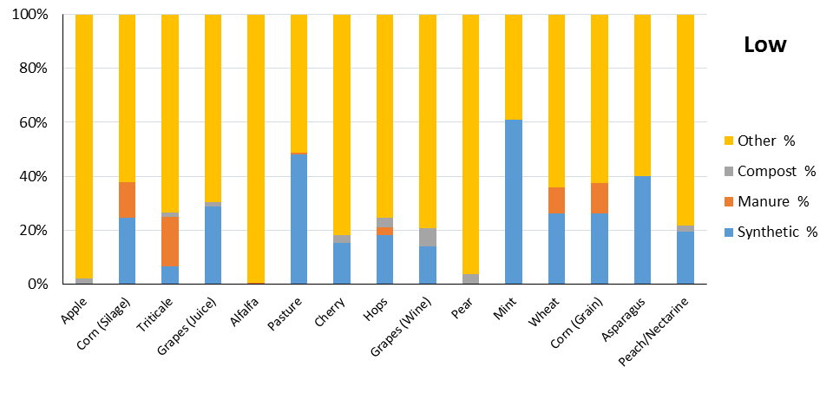
Irrigated Agriculture Inputs (Low)
“Other” category includes atmospheric deposition, irrigation water N concentration, residual N, soil organic matter conversion

Slide 42
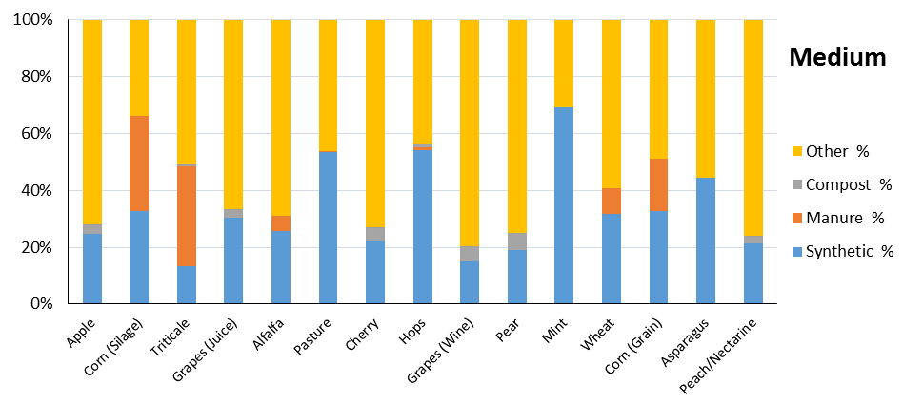
Irrigated Agriculture Inputs (Medium)
“Other” category includes atmospheric deposition, irrigation water N concentration, residual N, soil organic matter conversion

Slide 43
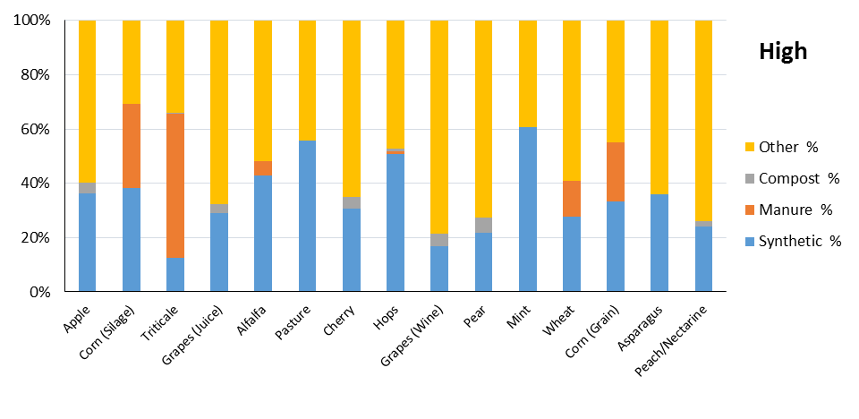
Irrigated Agriculture Inputs (High)
“Other” category includes atmospheric deposition, irrigation water N concentration, residual N, soil organic matter conversion

Slide 44
Irrigated Agriculture: Results
One year’s worth of inputs and outputs for the top 15 crops
Commodity | Acreage | Sum of inputs and outputs for one year (lb N/ac-yr)
 |  | Low | Medium | High
Apple | 17,333 | -5 | 91 | 219
Corn (silage) | 16,778 | -200 | 25 | 242
Triticale | 10,780 | -135 | -9 | 250
Grapes (juice) | 10,257 | 61 | 132 | 197
Alfalfa | 7,989 | -365 | -236 | -46
Pasture | 6,731 | -186 | -68 | 62
Cherry | 6,336 | 27 | 105 | 210
Hops | 5,961 | -84 | 78 | 113
Grapes (wine) | 5,126 | 40 | 94 | 156
Pear | 3,331 | -1 | 92 | 173
Mint | 1,418 | -166 | 73 | 157
Wheat | 1,283 | -79 | 23 | 113
Corn (grain) | 1,166 | -48 | 126 | 284
Asparagus | 854 | 58 | 157 | 210
Peach/Nectarine | 843 | 12 | 81 | 158

Slide 45
Irrigated Agriculture: Results
 | Estimated total N surplus in GWMA (ton N/yr)
Commodity | Low | Medium | High
Apple | - | 786 | 1,897
Corn (silage) | - | 208 | 2,029
Triticale | - | - | 1,346
Grapes (juice) | 312 | 677 | 1,008
Alfalfa | - | - | -
Pasture | - | - | 209
Cherry | 87 | 333 | 666
Hops | - | 232 | 337
Grapes (wine) | 103 | 240 | 400
Pear | - | 153 | 288
Mint | - | 52 | 111
Wheat | - | 14 | 72
Corn (grain) | - | 74 | 165
Asparagus | 25 | 67 | 90
Peach/Nectarine | 5 | 34 | 67
Total | 532 | 2,870 | 8,685

Slide 46
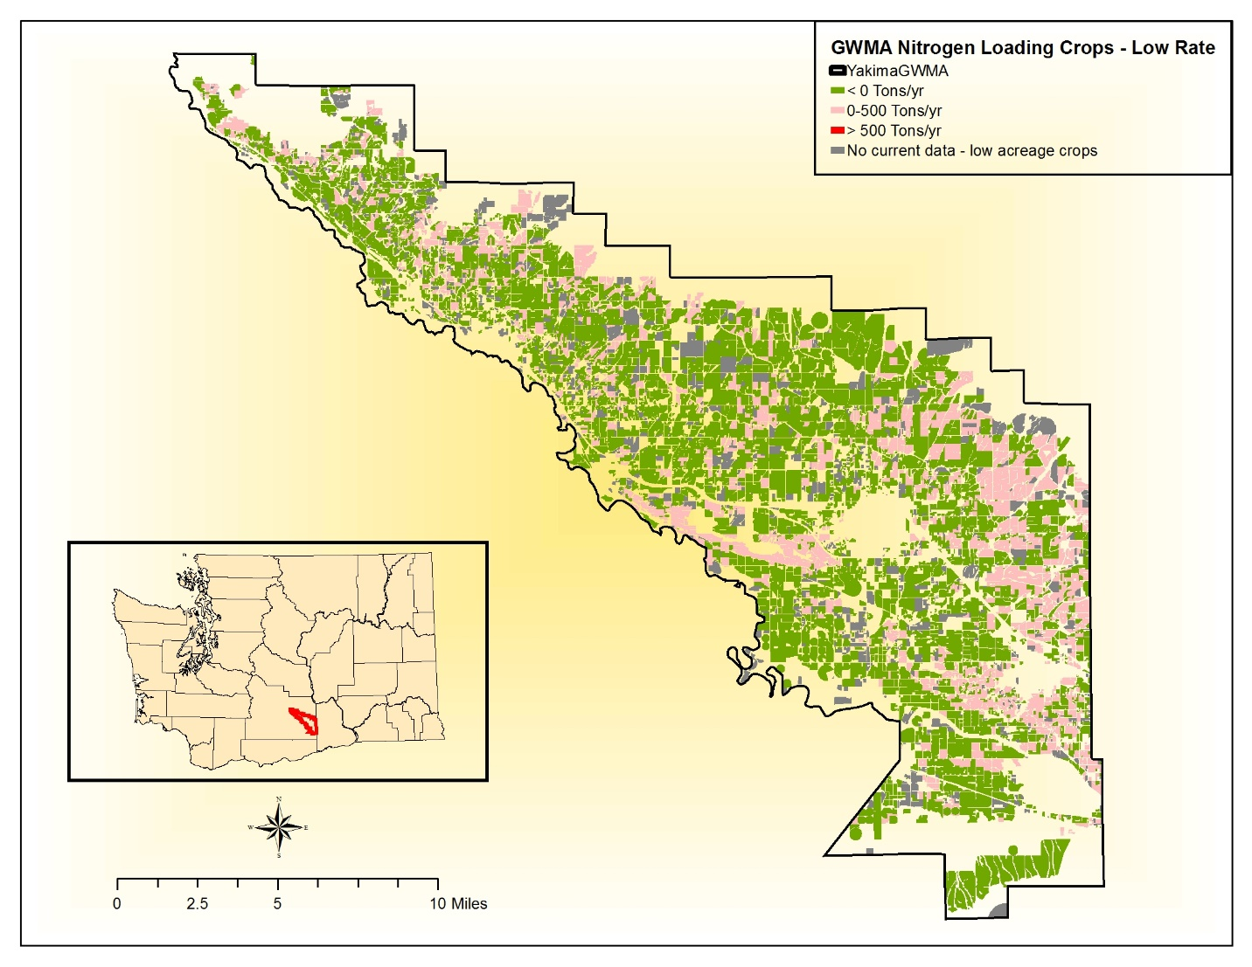
Irrigated Agriculture: GWMA low

Slide 47
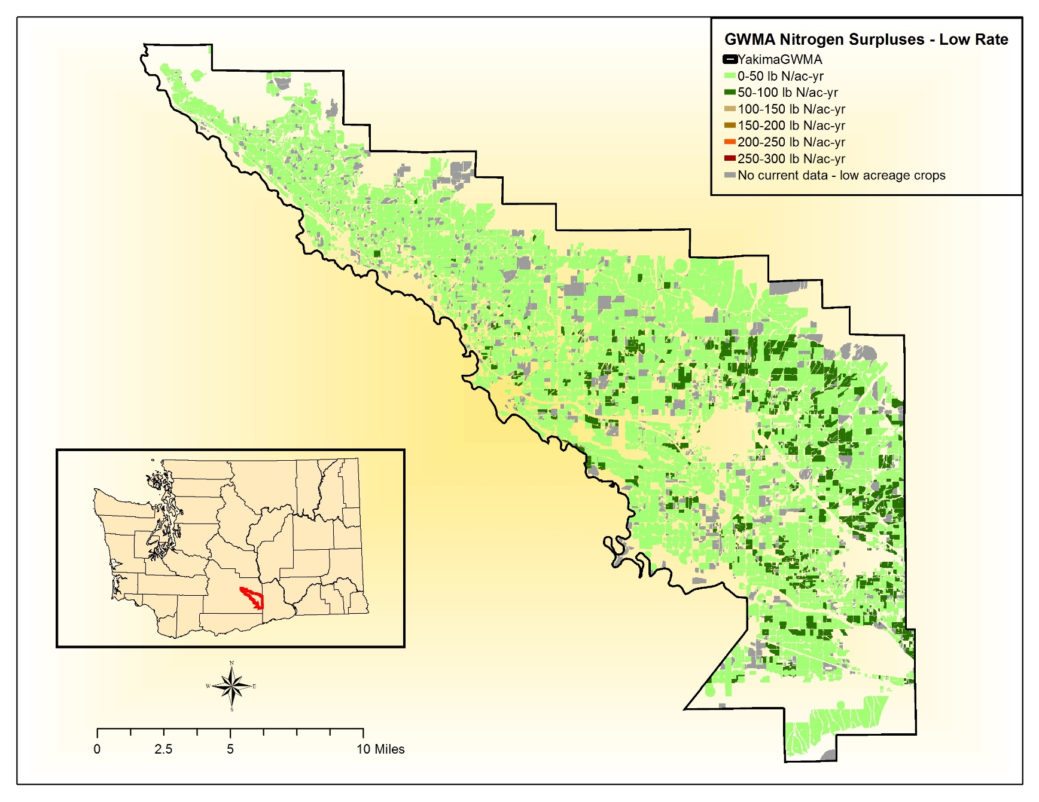
Irrigated Agriculture: per-acre low

Slide 48
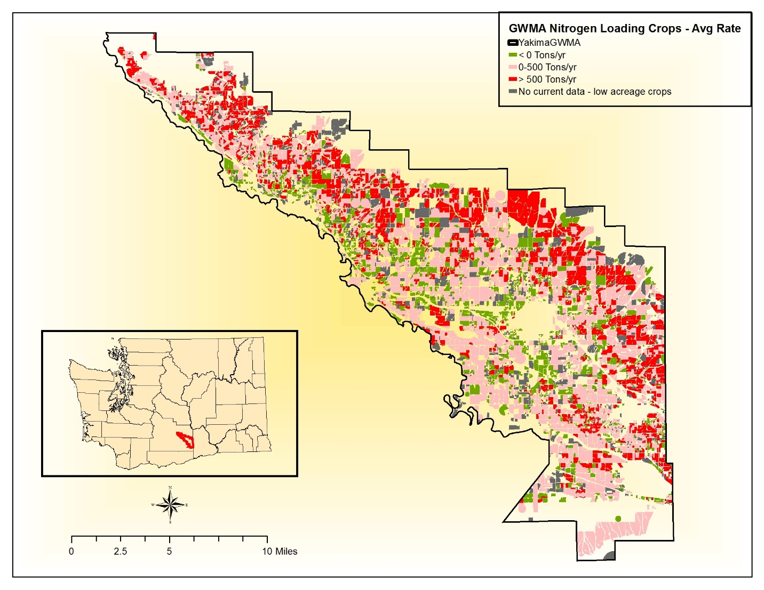
Irrigated Agriculture: GWMA average

Slide 49
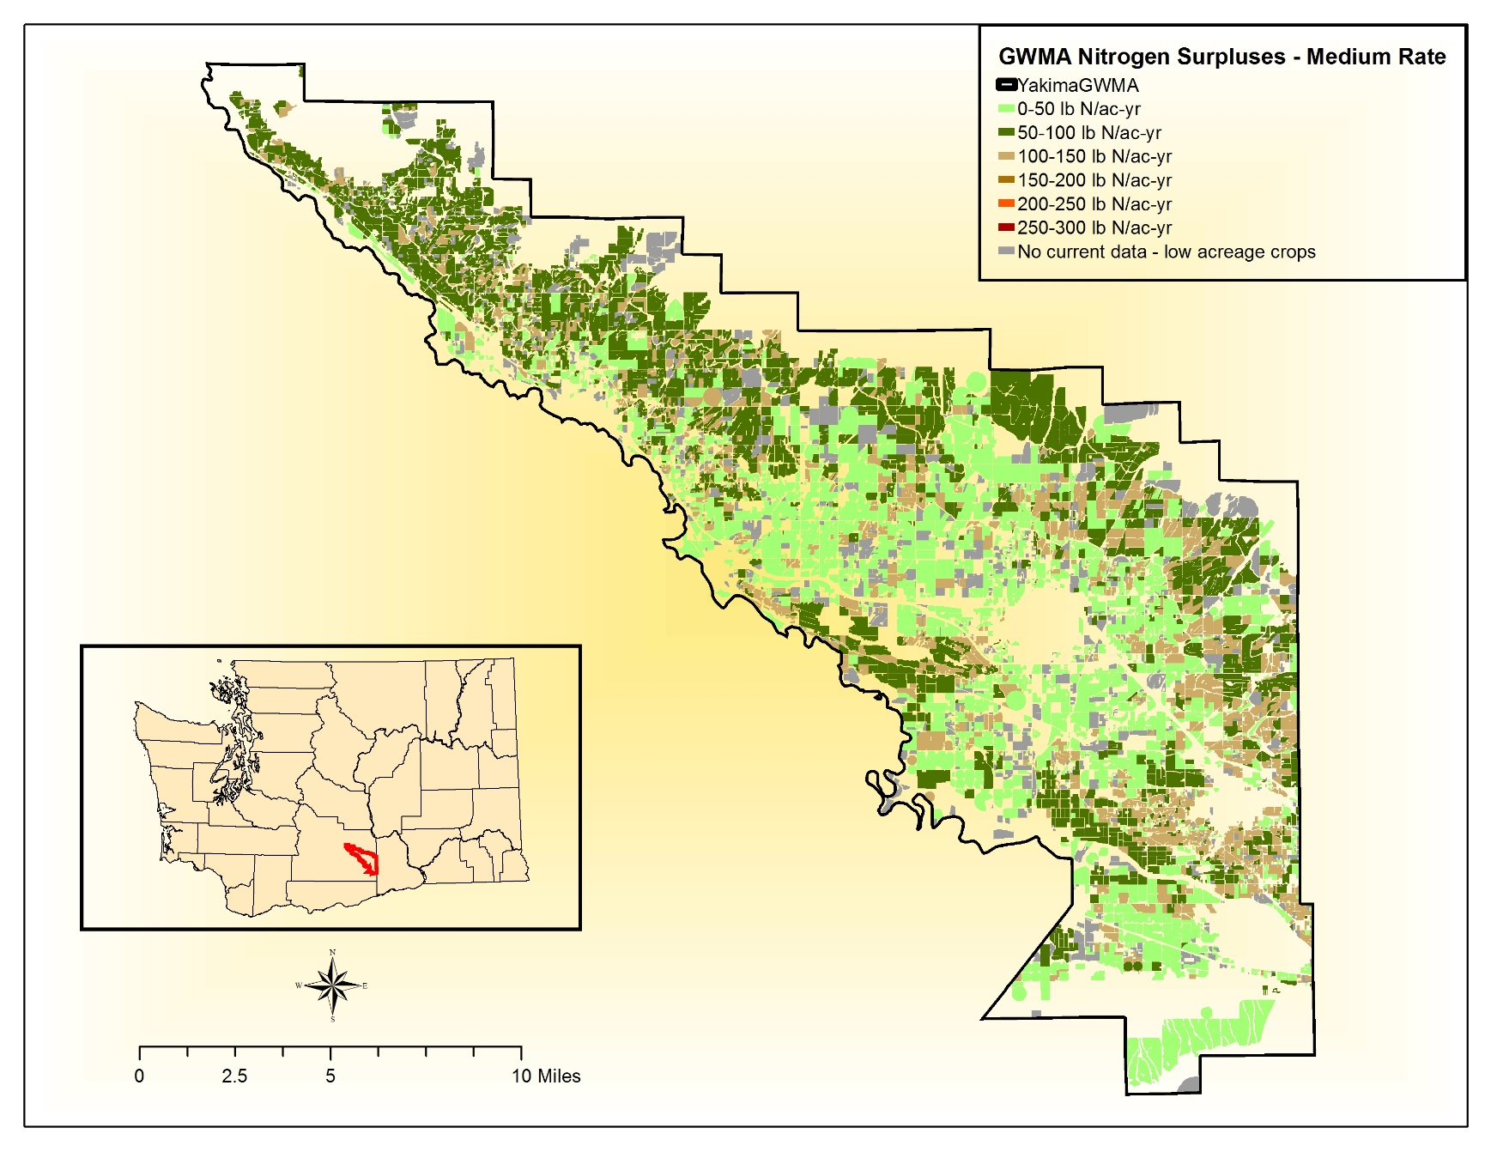
Irrigated Agriculture: per-acre average

Slide 50
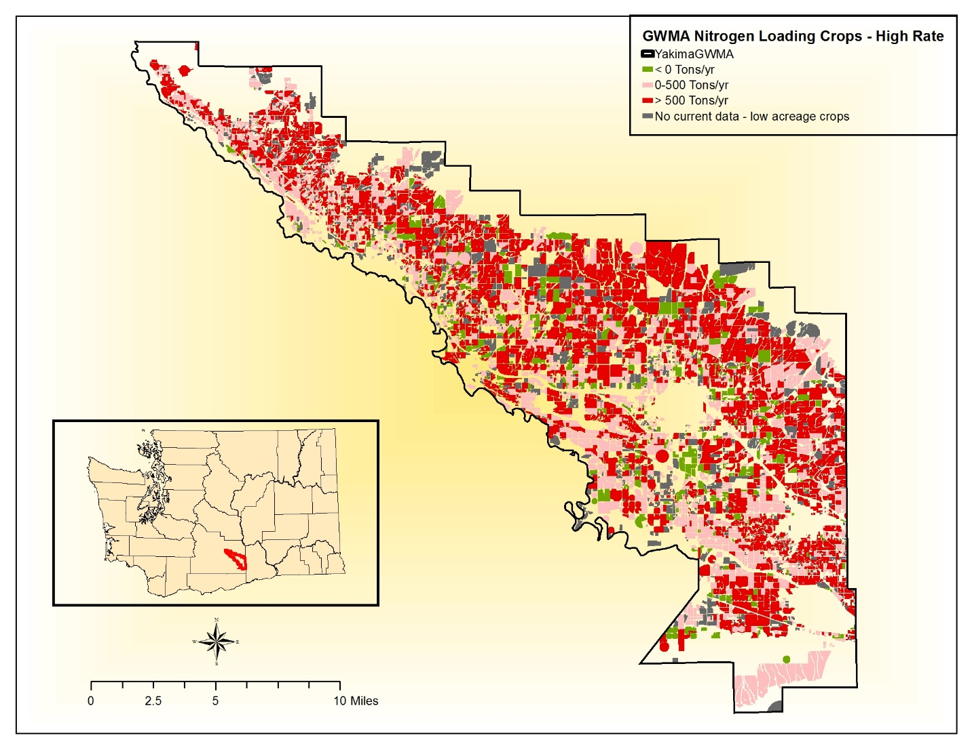
Irrigated Agriculture: GWMA high

Slide 51
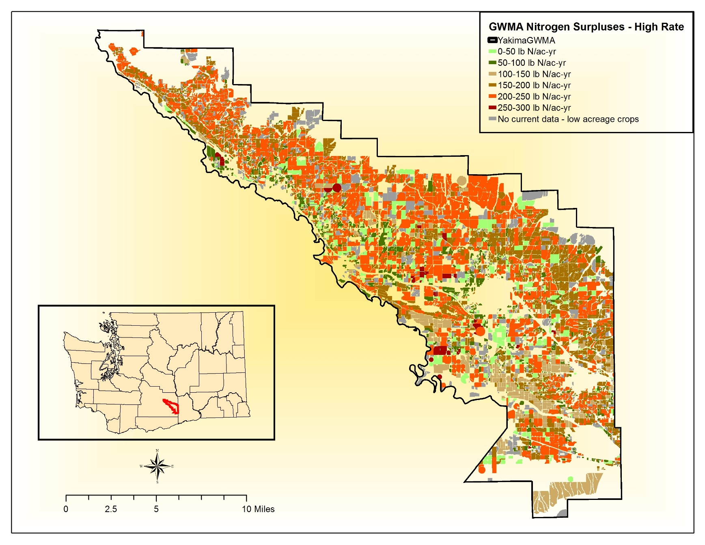
Irrigated Agriculture: per-acre high

Slide 52
ATMOSPHERIC DEPOSITION

Slide 53
Atmospheric Deposition: Methods
    Low rate: most recently reported wet and dry deposition at Mt Rainier station (2012 data)
    Medium rate: 5 day modeled average from December 2015
    High rate: medium value was multiplied by factor of 3 (Ecology atmospheric scientist recommendation)
 | Deposition rate (lb N/ac)
Low | 1.53
Medium | 2.05
High | 6.15

Slide 54
Atmospheric Deposition: Results
 | Total Deposition (tons N/yr)
Low | 57
Medium | 76
High | 227

Slide 55
ANALYSIS OF ALL SOURCES

Slide 56
Overall Results
Over the entire GWMA acreage, irrigated agriculture, CAFO lagoons, and CAFO pens were the largest contributors of nitrogen available for transport
HOWEVER
On a per-acre basis the largest contributors of nitrogen available for transport are different.
  CAFO Pens, Lagoons, Septic (ROSS, LOSS, COSS)

Slide 57
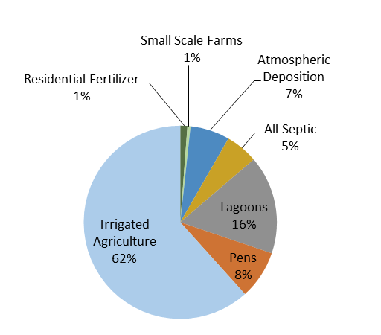
Whole GWMA Acreage (low)
Estimated Loading from Commercial Agriculture 86%

Slide 58
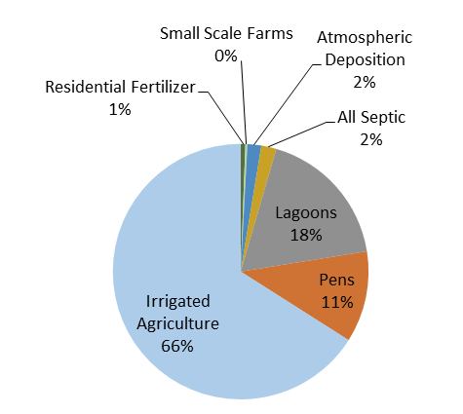
Whole GWMA Acreage (medium)
Estimated Loading from Commercial Agriculture 95%

Slide 59
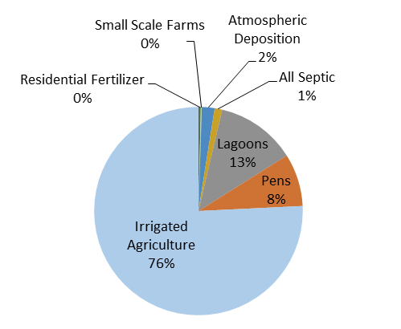
Whole GWMA Acreage (high)
Estimated Loading from Commercial Agriculture 97%

Slide 60
Per-acre available nitrogen
Source | Area (acres) | Low (lb/acre-year) | Medium (lb/acre-year) | High (lb/acre-year)
Irrigated Agriculture | 96,186 | 11 | 60 | 181
CAFO Pens | 2,096 | 67 | 480 | 892
CAFO Lagoons | 210 | 1,354 | 7,448 | 13,542
RCIM ROSS* | 398 | 223 | 403 | 662
RCIM LOSS* | 3 | 195 | 209 | 225
RCIM COSS* | 30 | 163 | 173 | 183
RCIM Residential Fertilizer | 4,381 | 4.7 | 11.7 | 18.6
RCIM Small Scale Farms | 2,096 | 4.3 | 10.7 | 17.1
Atmospheric Deposition | 73,976 | 1.53 | 2.05 | 6.15

Slide 61
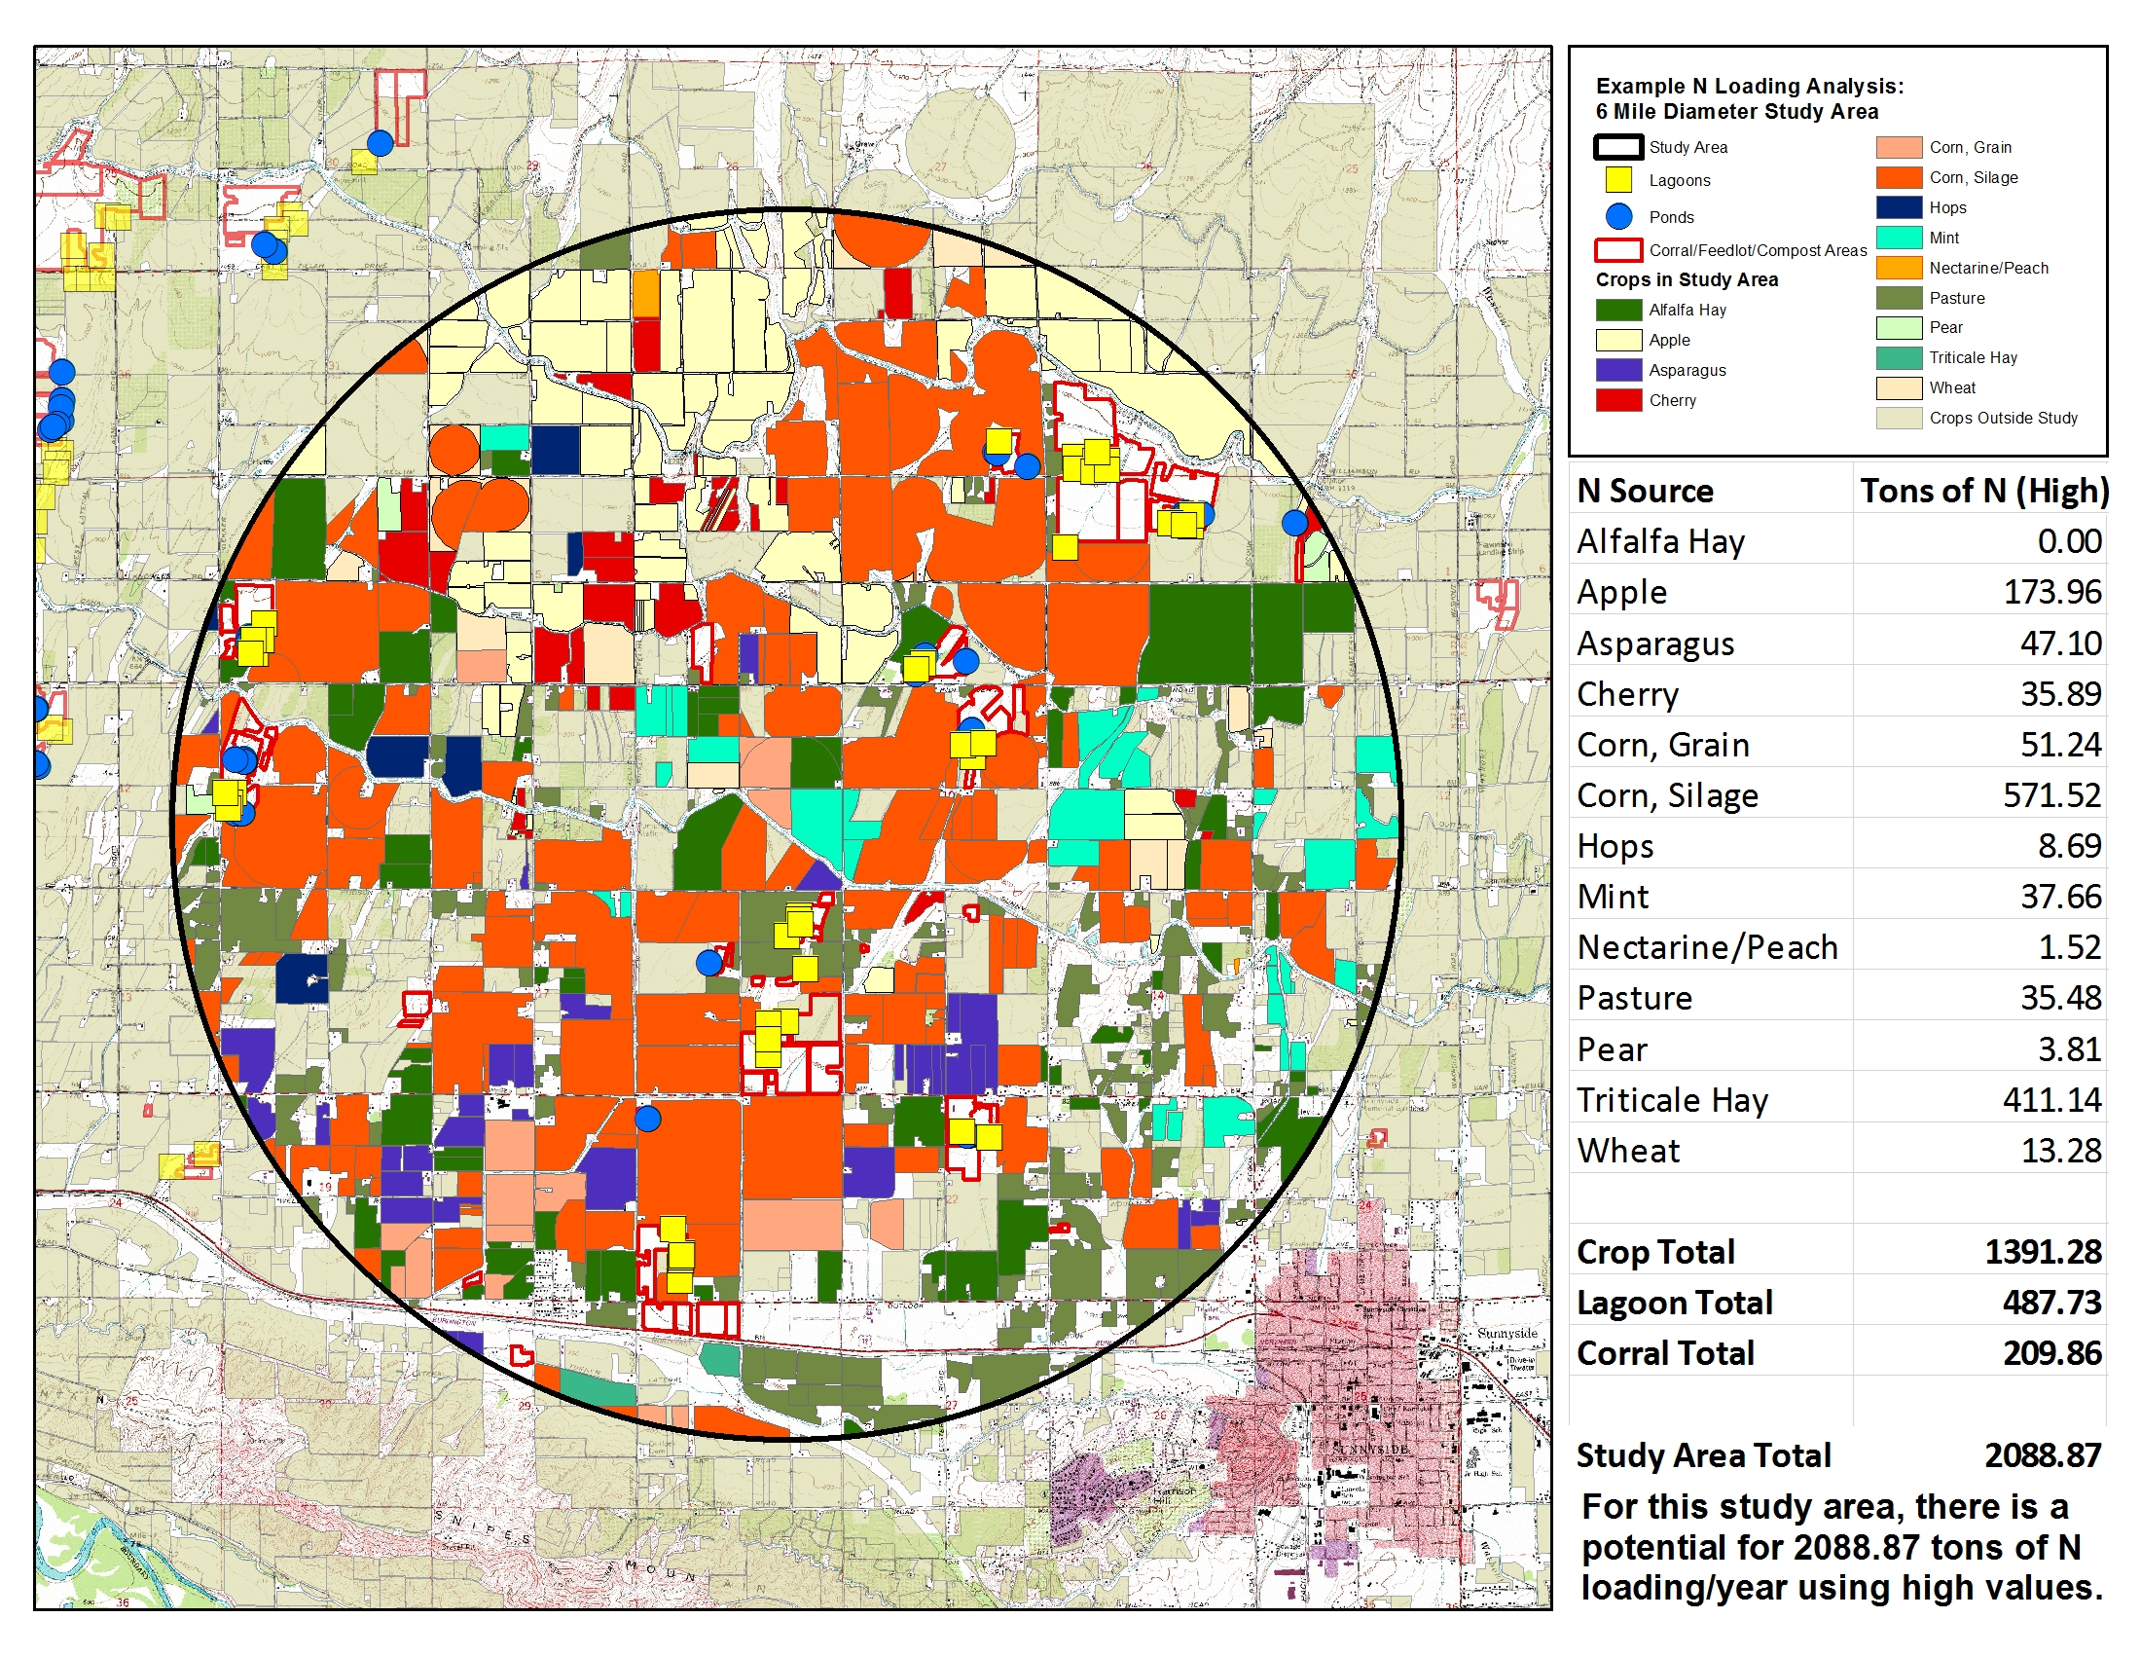
GIS Tools Example

Slide 62
Conclusions
Study highlights focus areas for future management to protect ground water
Products can be updated in the future as additional data becomes available.
WSDA and Ecology are engaged in work that will aggregate information about lagoon conditions and that could be used to adjust loading estimates.
WSDA has identified research needs to improve estimates.

Slide 63
Future Research
Compare irrigated ag mass balance results to deep soil sampling results to calibrate model.
Nitrogen mineralization and utilization studies for fertilizer guides and nutrient management
Conduct field study of lagoon seepage to improve lagoon calculations.
Background research on lagoon condition classification, rating, construction standard, and liner condition.
Soil sampling in CAFO pens and compost areas.

Slide 64
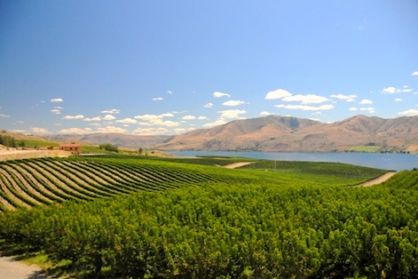
Questions?

Slide 65
Washington State Department of Agriculture
Gary Bahr
Natural Resources Assessment Section Manager
360.902.1936
kcook@agr.wa.gov
Margaret Drennan
Lead Report Author
360.725.5769
mdrennan@agr.wa.gov
Kelly McLain
Western WA Supervisor
360.902.2067
kmclain@agr.wa.gov
Perry Beale
Eastern WA Supervisor
360.951.9098
pbeale@agr.wa.gov
http://www.agr.wa.gov/PestFert/NatResources/

Slide 66
History

Slide 67
Lagoon Nitrogen Concentration
 | EPA | SYCD | Combined
Sample Size | 15 | 23 | 38
Minimum | 290 | 180 | 180
Q1 | 1000 | 355 | 455
Median | 1400 | 768 | 1028
Mean | 1212 | 949 | 1054
Mode | 1200 | 336 | 1200
Q3 | 1600 | 1092 | 1401
Maximum | 1800 | 3633 | 3632
Standard Deviation | 492 | 802 | 702

Slide 68
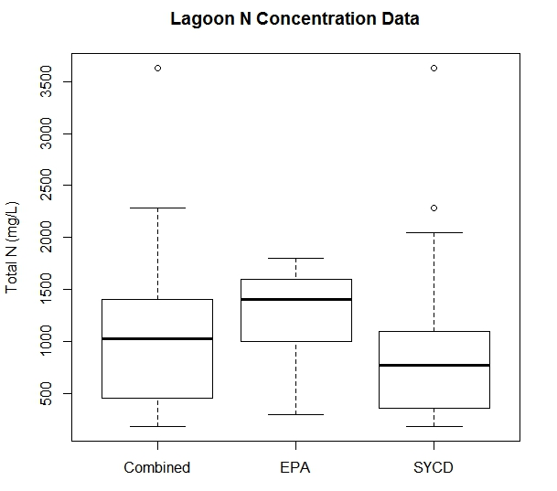
Lagoon Nitrogen Concentration

Slide 69
Lagoon Surface Area

Slide 70
Lagoon Surface Area

Slide 71
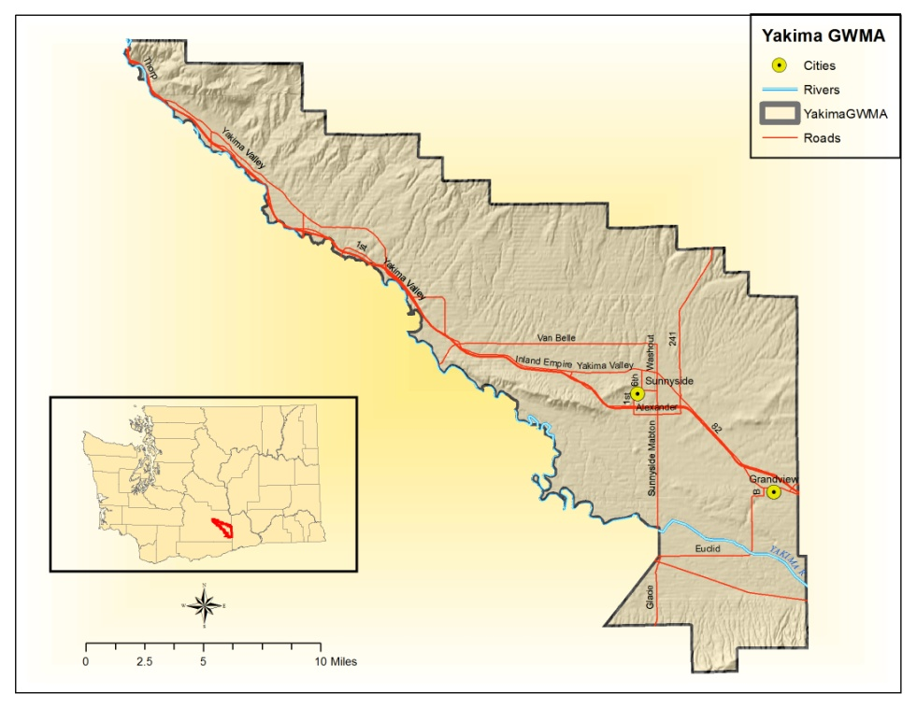
Yakima Groundwater Management Area (GWMA)

Slide 72
Yakima GWMA Background
Yakima County, about 250,000 people
Agriculture, $1.65 billion (USDA NASS 2014)
Major commodities apples, milk, and hay
96,186 acres, irrigated farmland (WSDA 2016)
More than 50 dairy farms, also heifer replacement and beef feedlots
  2,096 acres of pens, 210 acres of lagoons
Over 6,000 Residential Onsite Septic Systems (ROSS), other septic, and urban/rural fertilizer

Slide 73
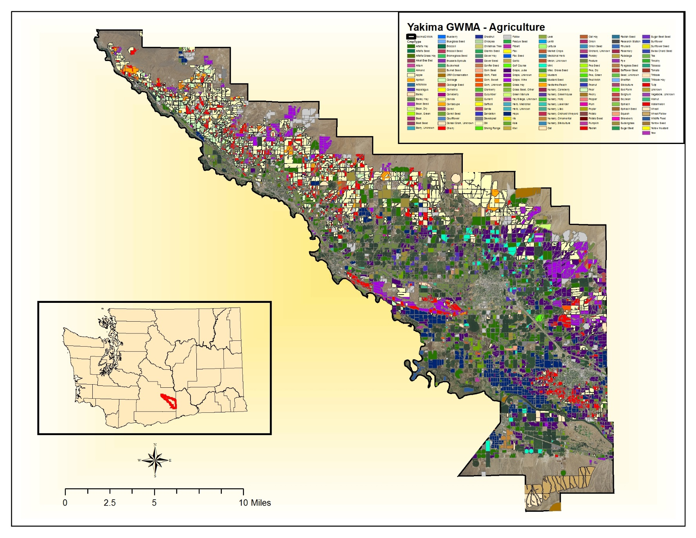
Yakima Groundwater Management Area (GWMA) Crops

