Slide 1

State of the County 2019 Board of Yakima County Commissioners
Mike Leita, District One
Ron Anderson, District Two
Norm Childress, District Three
ML

Slide 2
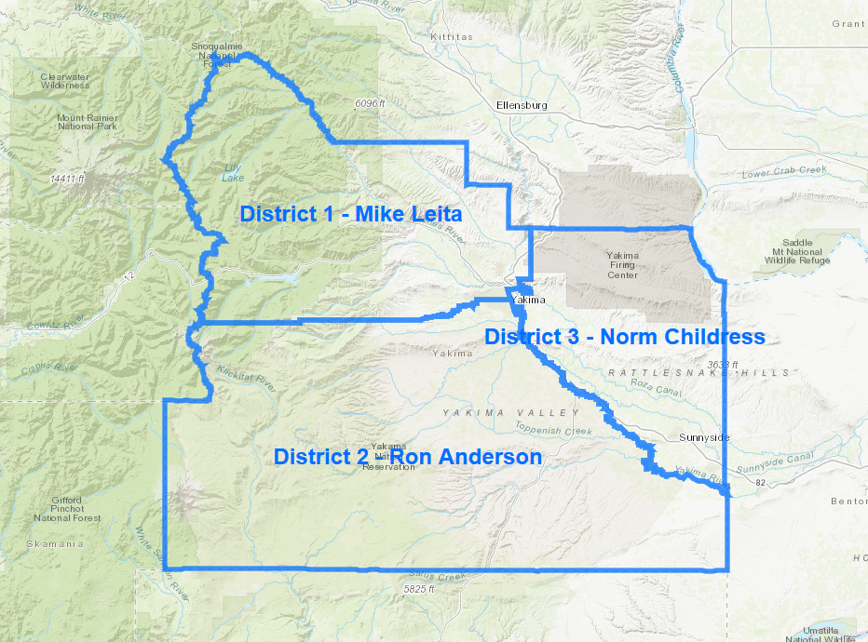
Who Represents Me?
Mike Leita
District One
Selah, Gleed, Naches
Yakima (North of Tieton Ave., West of Front Street)
Ron Anderson
District Two
Union Gap, Ahtanum, Wapato, Toppenish, Mabton
Yakima (South of Tieton Ave)
Norm Childress
District Three
Terrace Heights, Moxee, Zillah, Granger, Sunnyside, Grandview
Yakima (East of Front Street)
ML

Slide 3
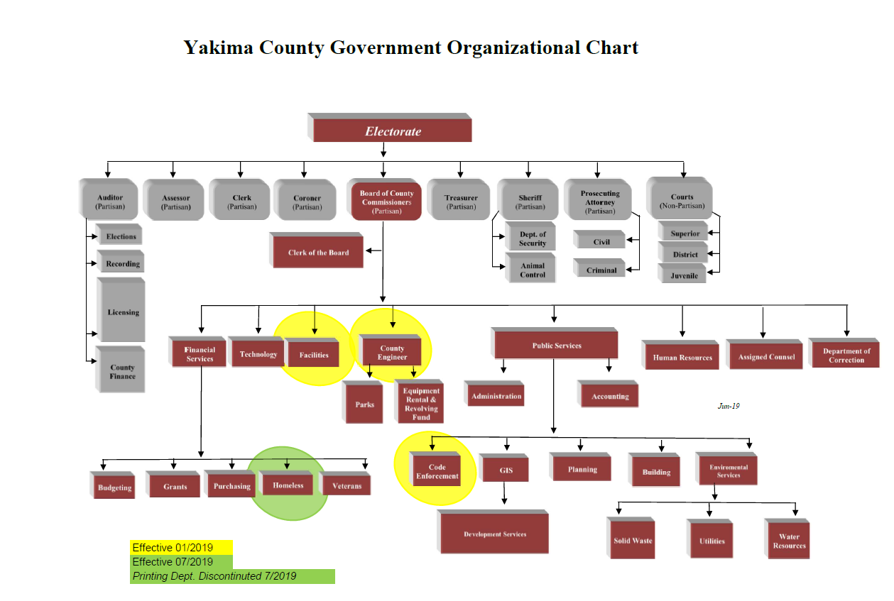
ML

Slide 4
County Board of Commissioners Serve on 30 Boards
9-1-1 Administrative Board
Aging and Long Term Care Board
Canvassing Board
Clean Air
Columbia River Basin County Commissioner Policy Advisory Group
Conference of Governments –Executive Committee
Conference of Governments –General Membership
Countywide Planning Policy Committee
DRYVE / Trans-Action Committee
Emergency Services Council
Greater Columbia Behavioral Health
Greater Yakima Chamber of Commerce (ex officio)
Health District Board
Hearing Examiner Joint Committee
Law Library Board
LEOFF 1 Disability Board
S.I.E.D Board
Solid Waste Management Advisory Committee
South Central Workforce Consortium
Sports Commission Board
State Fair Board (ex officio)
Tourism Board
Treasurer’s Finance Committee
Visitor & Convention Bureau
WSAC Board of Directors
WSAC Legislative Steering Committee
Yakima County Development Association
Yakima Basin Fish & Wildlife Recovery Board
Yakama Nation 2% Allocation Committee
Yakima Homeless Coalition
RA

Slide 5
Commissioner Appointed Citizen Boards
Benton County Mosquito
Boundary Review Board
Board of Equalization
CEDS Board
Clean Air Authority
Civil Service Commission
Drainage Improvement Districts
Health District Board
Horticultural Pest & Disease Board
Irrigation Districts
Mosquito Control District
Noxious Weed Control District #1
Selah Parks and Recreation Service Area
Sewer Districts
S.I.E.D Board
South Central Workforce Development Council
Veteran’s Advisory Board
Yakima County Planning Commission
Yakima Valley Regional Library Board
Yakima Homeless Coalition Executive Board
RA

Slide 6
Department of Financial Services Priorities of Government Budgeting Model and Policy
Law
Justice
Public Safety
Public Services
Government Services
Economic Development
Quality of Life
Health and Human Services
ML

Slide 7
2019 General Fund Revenue
$67,473,246
ML

Slide 8
2019 General Fund Expenses
$67,473,246
ML

Slide 9
2019 Designated Fund Expenses
$170,121,222
ML

Slide 10
2019 Expenses by Priorities
ML

Slide 11
Public Services 2019 Priority List
East-West Corridor Project
Terrace Heights Drive Widening
Code Enforcement
Yakima Basin Integrated Plan (YBIP)
Ground Water Management Area (GWMA)
NC

Slide 12
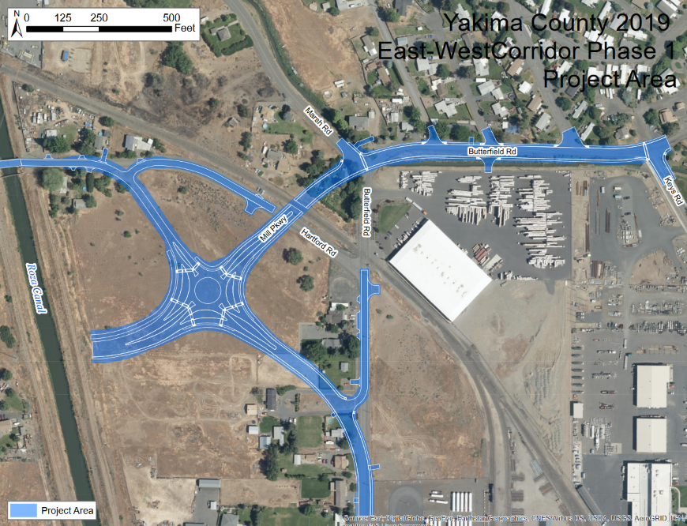
East-West Corridor
Transportation Project
PHASE I
Phase I Project Area
Construction Begins 2019
SIED Funded
NC

Slide 13
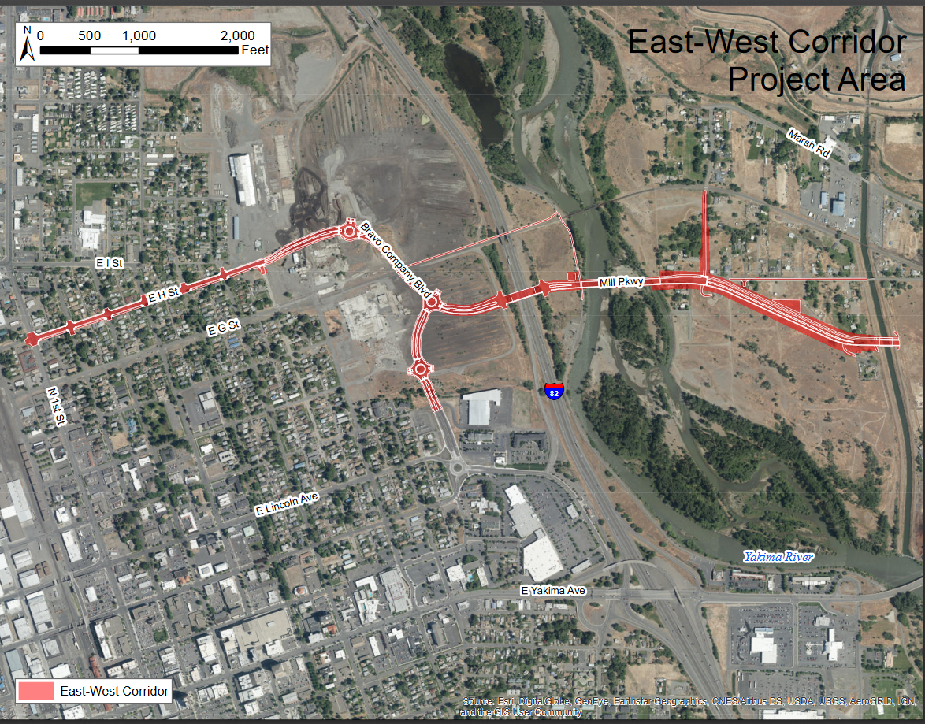
Phase II Project Area
SIED Funded
State funds to be available in 2020 for Phase II
NC

Slide 14
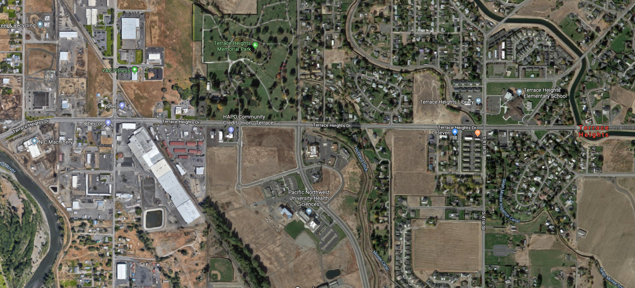
Terrace Heights Drive Widening
NC

Slide 15
Yakima County Code Enforcement
Created Code Enforcement Department and restructured by separating Building and Planning Code issues
Prioritize backlog of enforcement cases within the Building and Planning Departments
Drafting new ordinance for streamlined Code Enforcement
RA

Slide 16
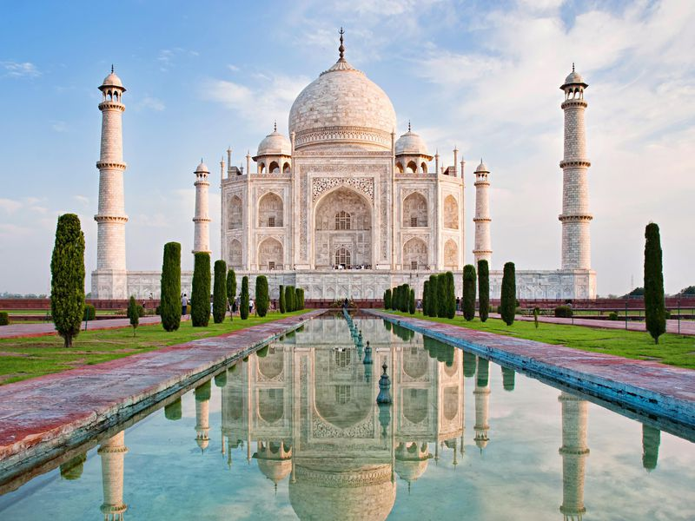
2019 Facilities Priority List
ML

Slide 17
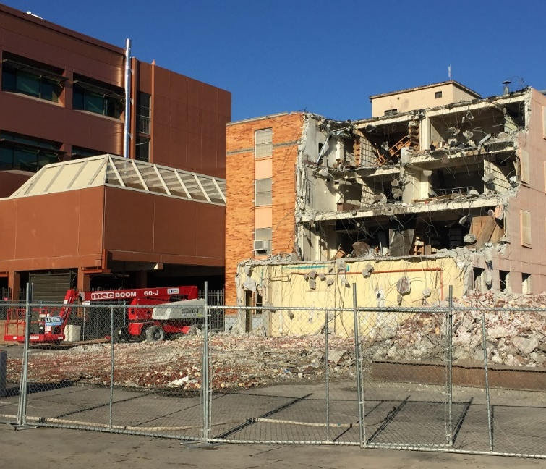
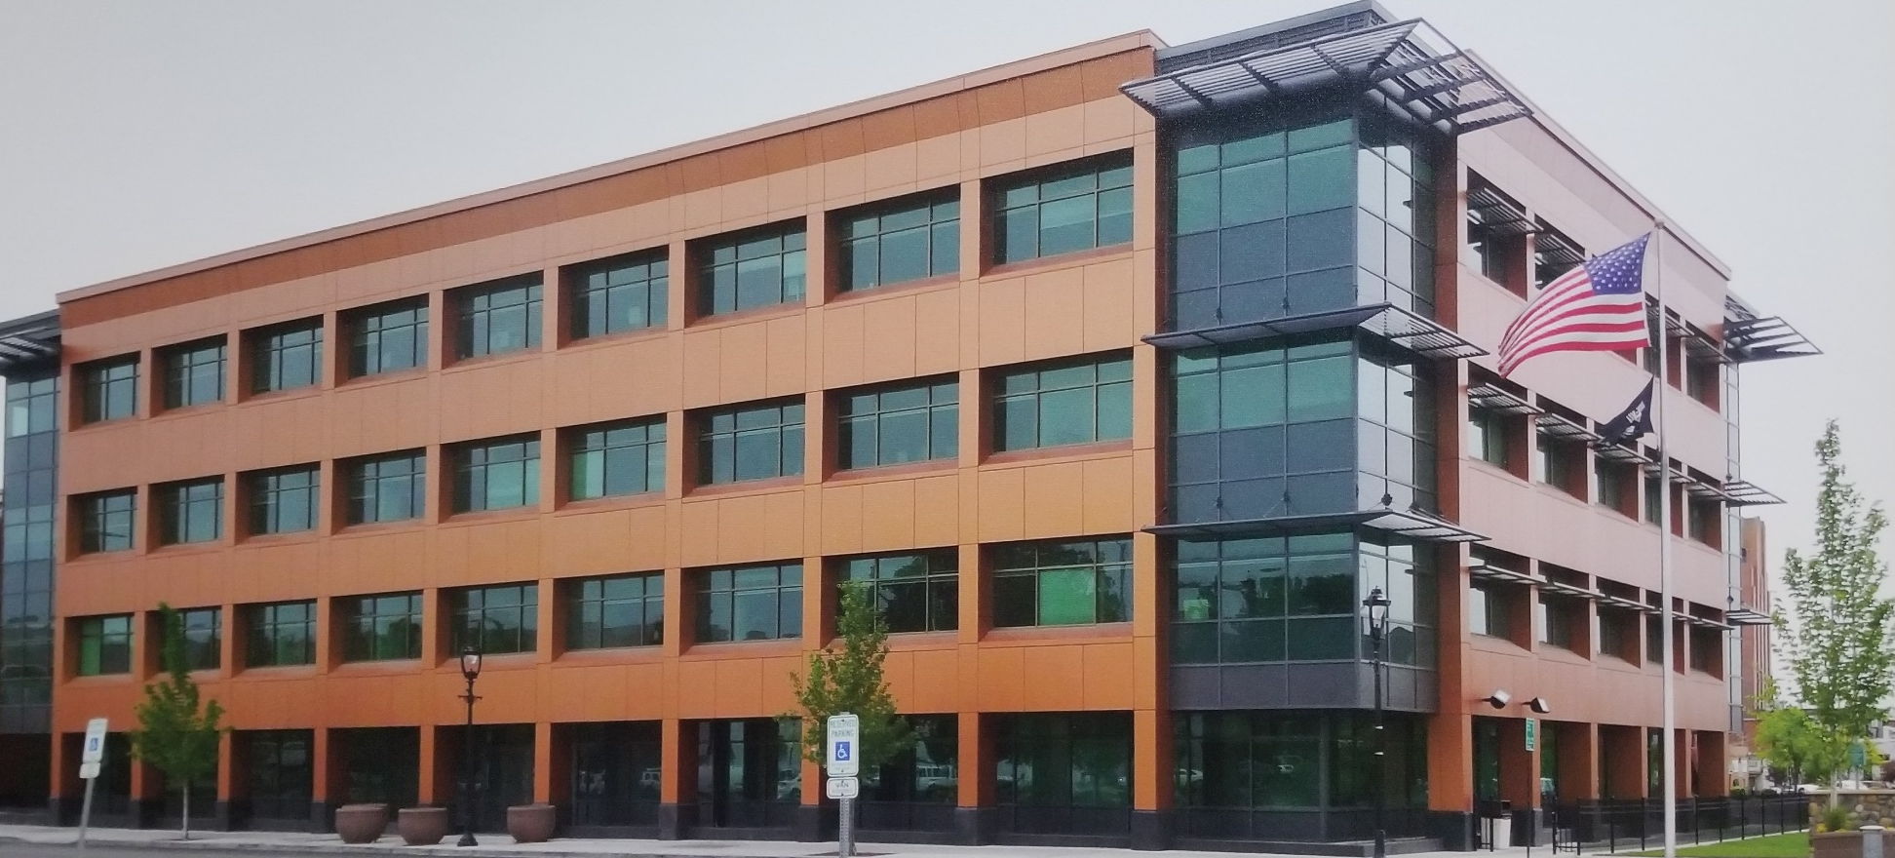
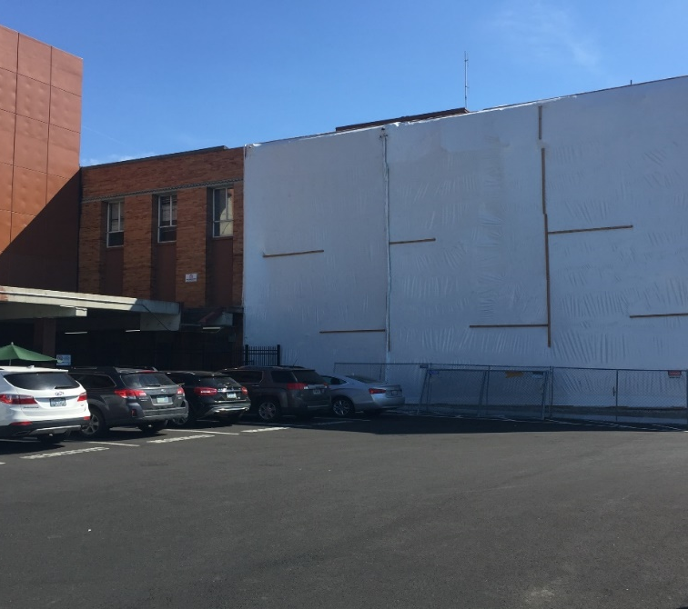
2020 - 2030 Plan Accomplishments
ML

Slide 18
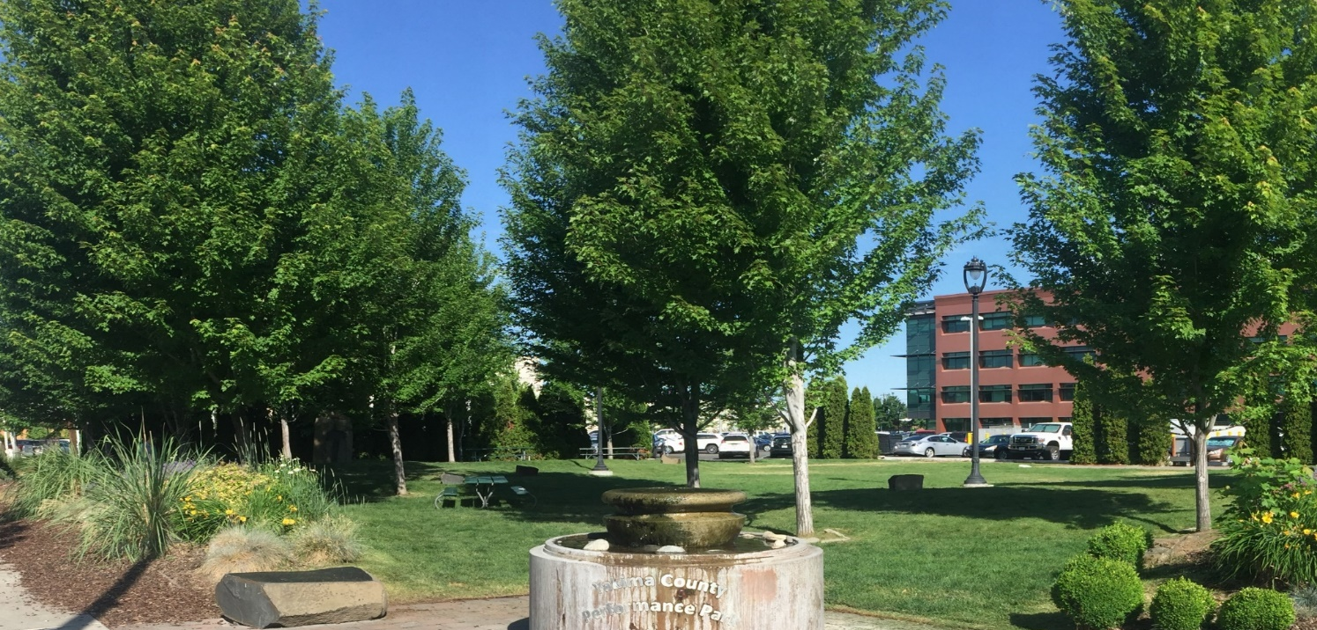
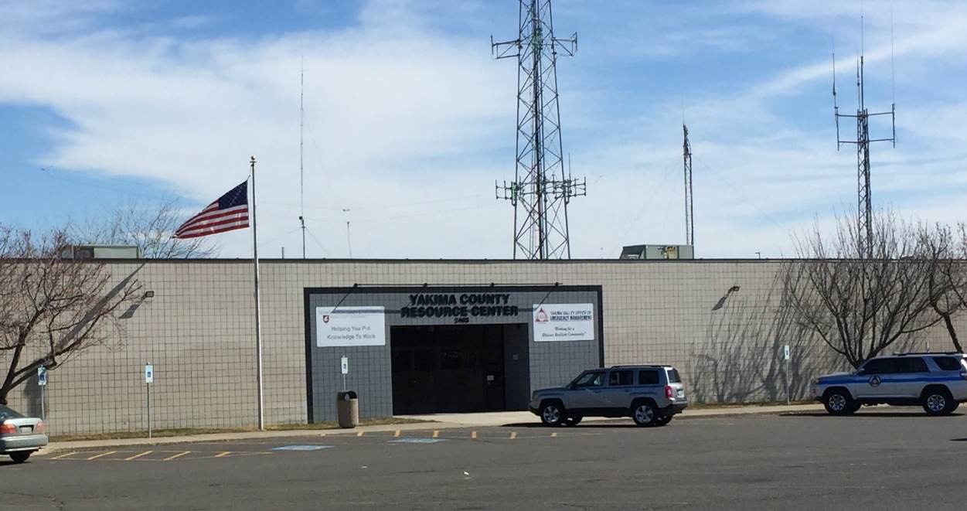
Converted Old
A-Street Buildings to Community Green Space
Converted Restitution Jail to Resource Center:
WSU Extension,
9-1-1 Call Center
EMS & EMT
ML

Slide 19
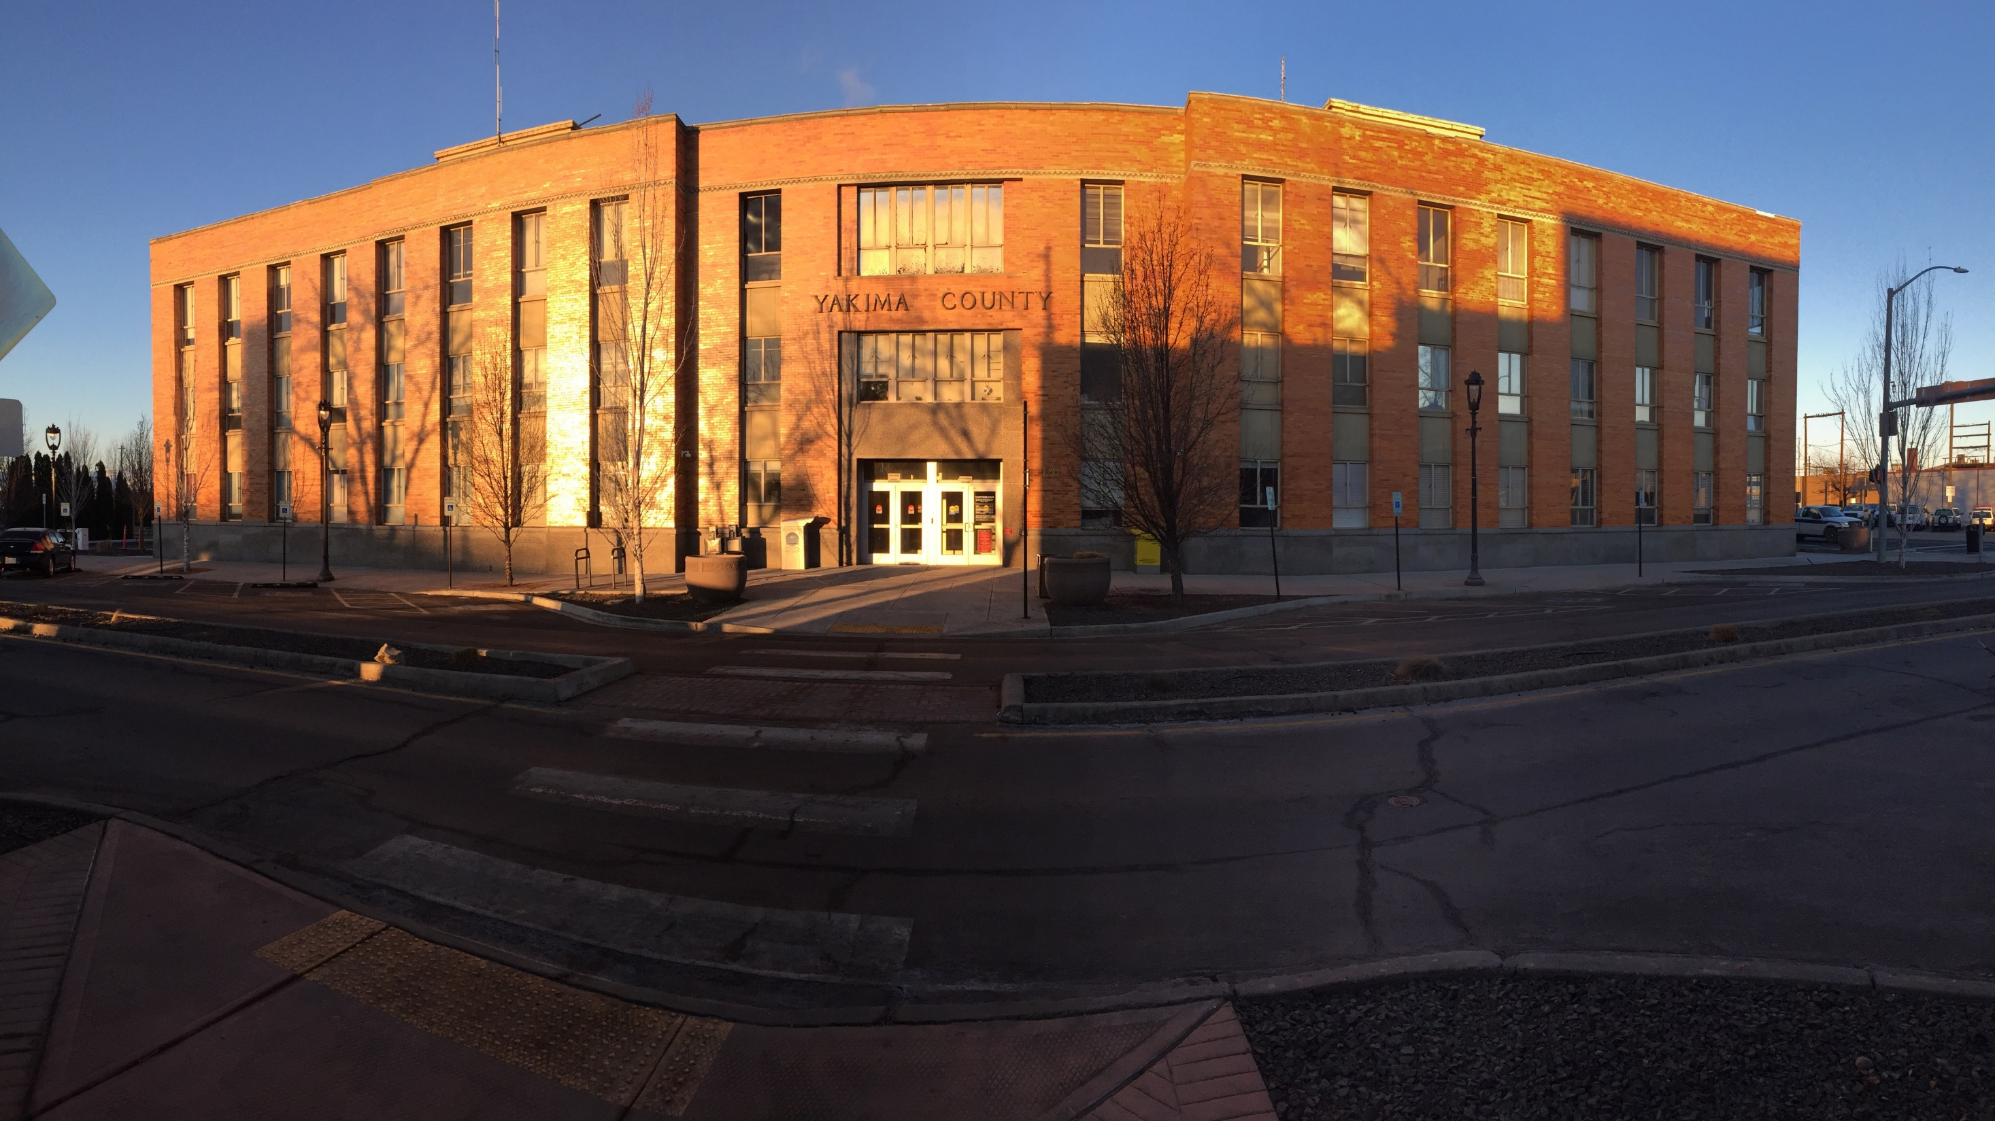
2040 Master Facilities Plan
Develop a plan to separate Yakima County Law and Justice and Administrative functions
Design the appropriate facility to house Law and Justice functions in a single facility
Construct a new facility in a manner which minimizes the impacts and downtime to Yakima County customers and department operations
Create a more efficient and safe Law and Justice service for Yakima County
RA

Slide 20
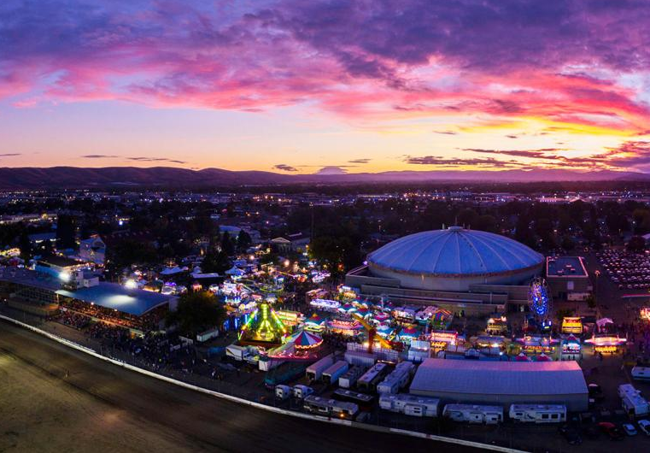
Fairgrounds Capital Facility Improvements
$8.5 Million Improvement Plan
Funded by existing Lodging Tax
Sun Dome Roof
Sun Dome Seating
ADA Compliance
General Refurbishment and Replacement of Structures
Better Fairgrounds Configuration
RA

Slide 21
Questions and Comments
Board of Yakima County Commissioners
Mike Leita, District One
Ron Anderson, District Two
Norm Childress, District Three
Clerk of the Board Melissa Paul
Deputy Clerk Linda Kay O’Hara
509-574-1500
RA

Slide 22
Yakima Basin Integrated Plan
Fish Passage
Structural Operational Changes
Surface Storage
Groundwater Storage
Habitat Restoration
Market-based Reallocation
Water Conservation

Slide 23

Yakima County Ground Water Management Area (GWMA)
Conducted SEPA on Plan
Initiated groundwater monitoring efforts
Complete the Groundwater Management Plan in 2019

